Slide 1
TGF-β

Slide 2
pTGFBR2
pSos
And Gate protein1
TGFBR2
pTGFB1
TGFB1

Slide 3
pTGFBR2
pGrb2
TGFBR2
And Gate protein2
pTGFB1
TGFB1

Slide 4
pTGFBR2
pShc
TGFBR2
And Gate protein3
pTGFB1
TGFB1

Slide 5
pTGFBR2
pSARA
TGFBR2
And Gate protein4
pTGFB1
TGFB1

Slide 6
TGFBR2
Smad2
ON

Slide 7
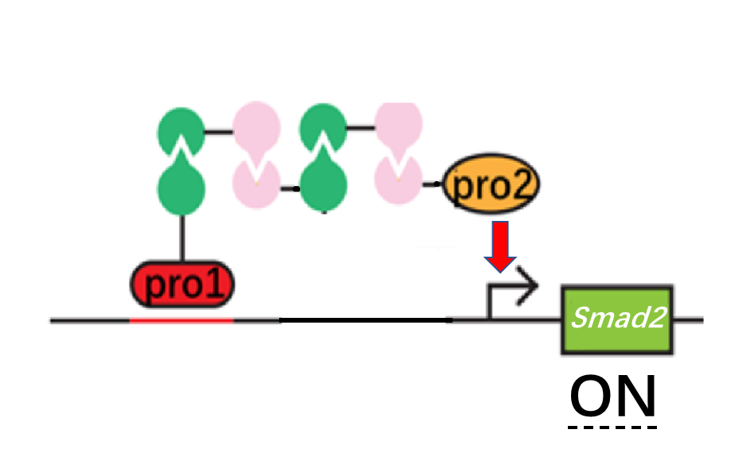
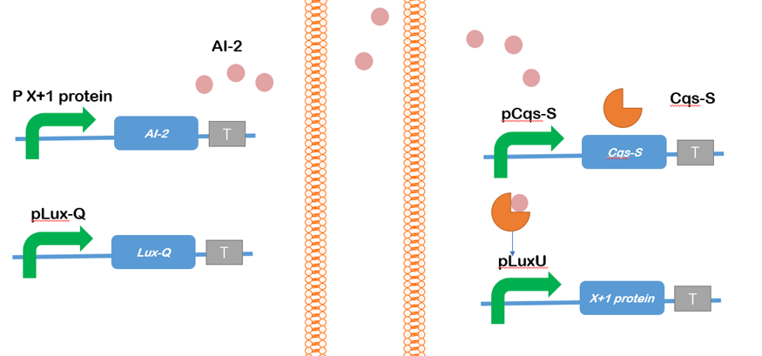
pRhoA
AI-2

Slide 8
RhoA

Slide 9
Wnt

Slide 10

pFZD-5
FZD-5
pCTNNB1
AI-2
pDvl
Dvl

Slide 11
CTNNB1

Slide 12
PI3K

Slide 13
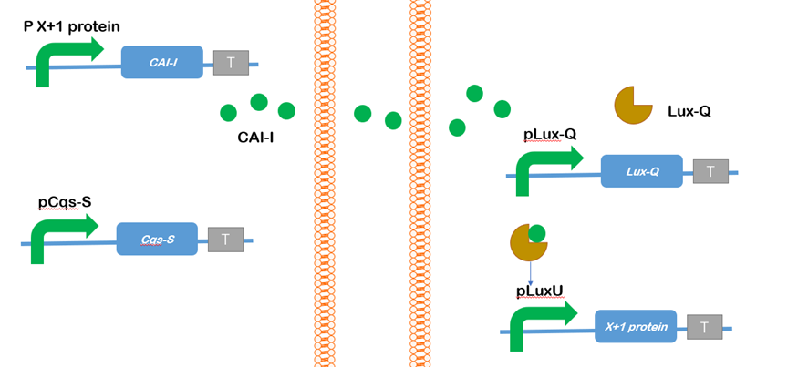
pEGFR
EGFR
pPI3K
CAI-1
pRas
Ras

Slide 14
pAkt
PI3K
AKT

